Slide 1


Maximum likelihood
Richard Telford
EECRG, Dept. Biology
richard.telford@bio.uib.no

Slide 2
Assumptions of least squares linear models
1. The relationship between the response and the predictors is ~linear.
2. The residuals have a mean of zero.
3. The residuals have constant variance (not heteroscedastic).
4. The residuals are independent (uncorrelated).
5. The residuals are normally distributed.
Count data, binomial and proportion data do not have normally distributed errors

Slide 3
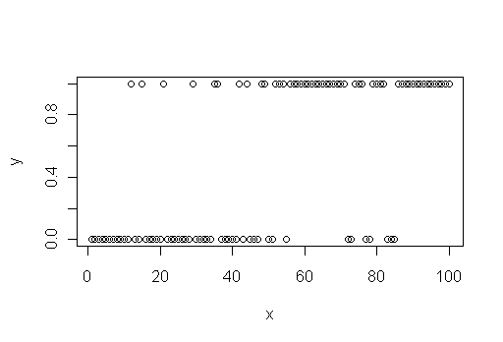
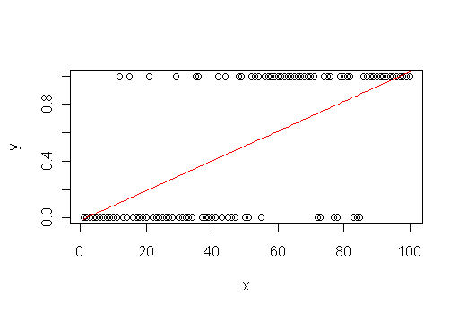
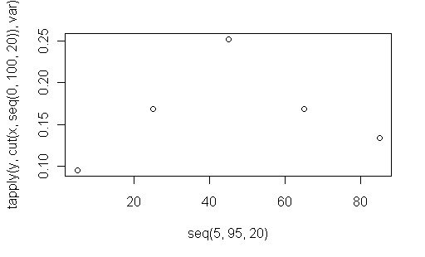
Binomial data
Success-failure data
Distribution bounded by 0 & 1
Least squares linear model fits impossible larger & smaller values
Non-constant variance
Need an alternative to least-squares

Slide 4
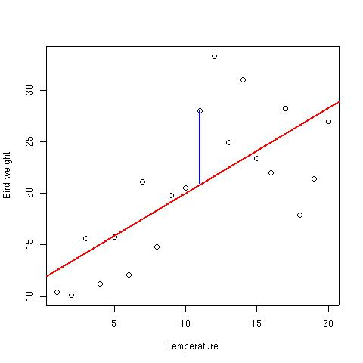
Least squares
y = response
x = predictor
y_{i} = β₀ + β₁x_{i} + ε_{i}
Σε_{i}² = Σ{y_{i} - (β₀ + β₁x_{i})}²

Slide 5
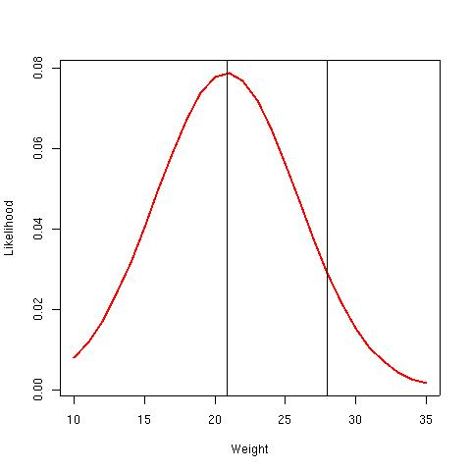
Maximum likelihood
How likely are the data given the model – choose model coefficients to maximise likelihood
We utilise a distribution
Normal distribution:
L(y;μ,σ) = {√(2πσ²)}⁻¹ exp{(-2σ²)⁻¹ (y_{i} - μ)²}

Slide 6
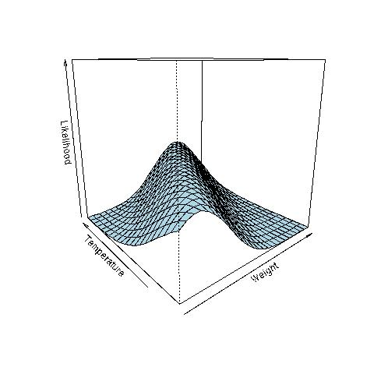
Maximum likelihood
There is a likelihood curve for all points

Slide 7
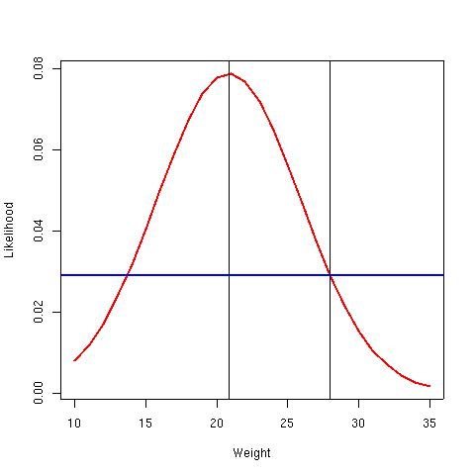
Maximum likelihood
For each point:
  Slice the likelihood
  Estimate the likelihood of the observation
The likelihood of the observation given the μ and σ
L(28; 20, 5) = 0.029

Slide 8
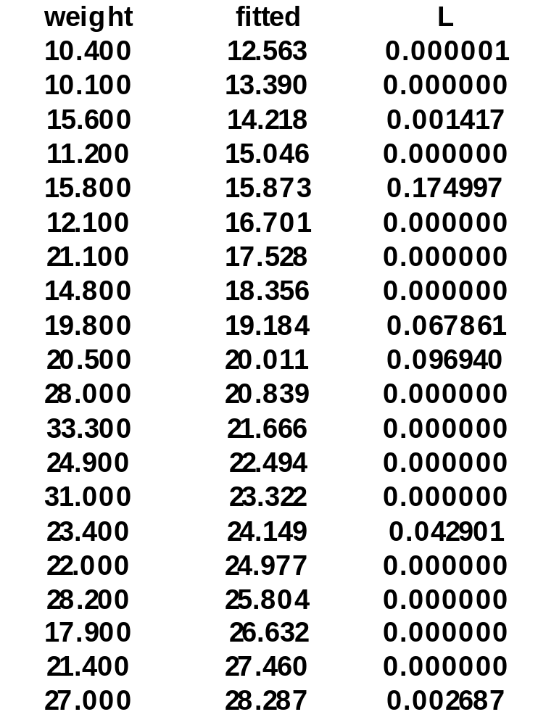
Maximum likelihood
L(weight; fitted, σ)
ŷ_{i} = β₀ + β₁x_{i}
σ = √{(n-p)⁻¹Σ(y_{i} – ŷ_{i})²}
Independent observations:
  Combined Likelihood
  Product of all likelihoods

Slide 9
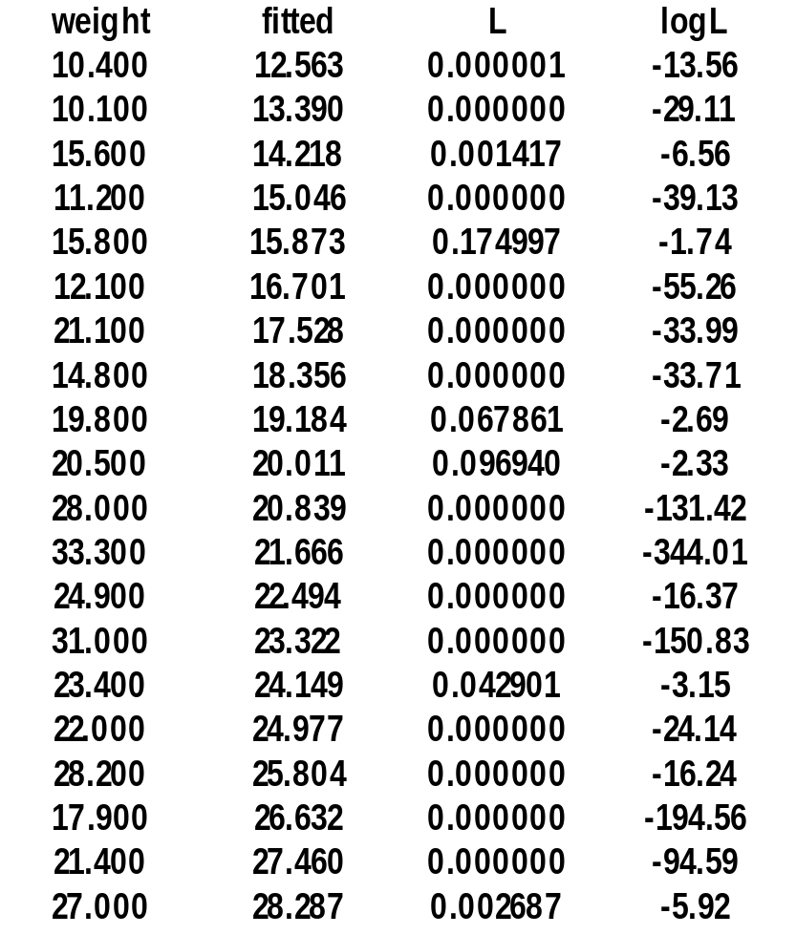
Maximum likelihood
Comb.prob = ΠL(y;μ,σ)
Logarithm of each L(y;μ,σ)
lL(y;μ,σ) = log(L(y;μ,σ))
Σ(IL(y;μ,σ)) = log(ΠL(y;μ,σ))
Log-likelihood:
    Σ(IL(y;μ,σ)) = -80.1

Slide 10
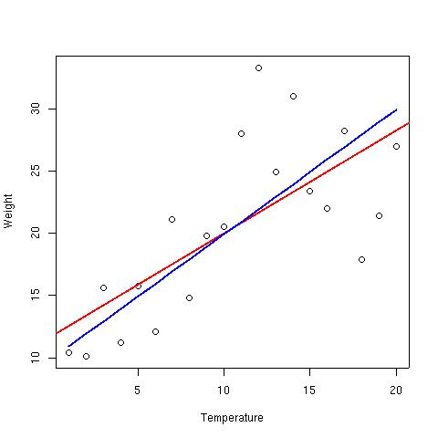
Maximum log-likelihood
We select β's for maximum log-likelihood
ŷ_{i} = β₀ + β₁x_{i}
σ = √{(n-p)⁻¹Σ(y_{i} – ŷ_{i})²}
b0 b1 sigma log-likelihood
11.3 0.83 5.06 -80.1
9.925 1 5.16 -82.1

Slide 11
Generalized Linear Model
fit.glm<-glm(weight~temp)
anova(fit.glm,test="F")
Df Deviance Resid. Df Resid. Dev F Pr(>F)
NULL 19 916.02
temp 1 455.47 18 460.55 17.801 0.0005158 ***
fit.lm<-lm(weight~temp)
anova(fit.lm)
Df Sum Sq Mean Sq F value Pr(>F)
temp 1 455.47 455.47 17.801 0.0005158 ***
Residuals 18 460.55 25.59

Slide 12
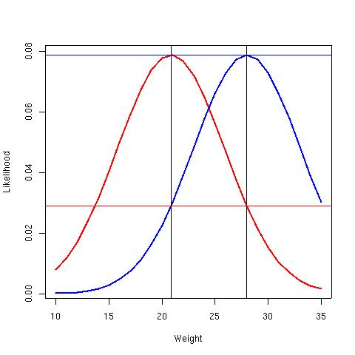
What is Deviance?
Estimate 'goodness of fit'.
log likelihood of fitted model – log likelihood of saturated model
D = 2{IL_{max}(y;μ,σ) - IL(y; y,σ)}
D = = σ⁻²Σ{y_{i} - (β₀ + β₁x_{i})}²
If Normal distribution, then
Scaled Deviance = Sum of Squares
σ²D = Σ{y_{i} - (β₀ + β₁x_{i})}²

Slide 13
Maximum likelihood in R
fit.glm<-glm(weight~temp)
anova(fit.glm,test="F")
Df Deviance Resid. Df Resid. Dev F Pr(>F)
NULL 19 916.02
temp 1 455.47 18 460.55 17.801 0.0005158
summary(fit.glm)
Estimate Std. Error t value Pr(>|t|)
(Intercept) 11.7353 2.3497 4.994 9.4e-05 ***
temp 0.8276 0.1962 4.219 0.000516 ***

Slide 14
Why Maximum Likelihood!
Robust
General:
  Other distributions
    Poisson
    Binomial
    Normal (Gaussian)
    Gamma
  Do not need constant variance
  Many link-functions

Slide 15
In R {fit.lm<-lm(weight~temp)}
y = response, y <- weight
mu = μ, mu <- fitted(fit.lm)
s2 = σ², s2 <- sum(resid(fit.lm)^2)/fit.lm$df.residual
L(y;μ,σ) = {√(2πσ²)}⁻¹ exp{(-2σ²)⁻¹ (y_{i} – μ)^2}
L1.fit<-1/sqrt(2*pi*s2)
L2.fit<-exp( (-1/(2*s2)) * (y-mu)^2 )
L.fit<-L1.fit * L2.fit

